Slide 1

Bidirectional visitor counter using 8051 Microcontroller
Under the Guidance of Prof. Nillima Kolhare
Presented by-
Guruprasad Dhore 112007020
Ram Dhalpe 112007018

Slide 2

Aim of the project
This project titled “Microcontroller based Bidirectional Visitor counter” is designed and presented in order to count the visitors of an auditorium, hall, offices, malls, sports venue, etc.
The system counts both the entering and exiting visitor of the auditorium or hall or other place, where it is placed. Depending upon the interrupt from the sensors, the system identifies the entry and exit of the visitor.
On the successful implementation of the system, it displays the number of visitor present in the auditorium or hall. This system can be economically implemented in all the places where the visitors have to be counted and controlled.

Slide 3
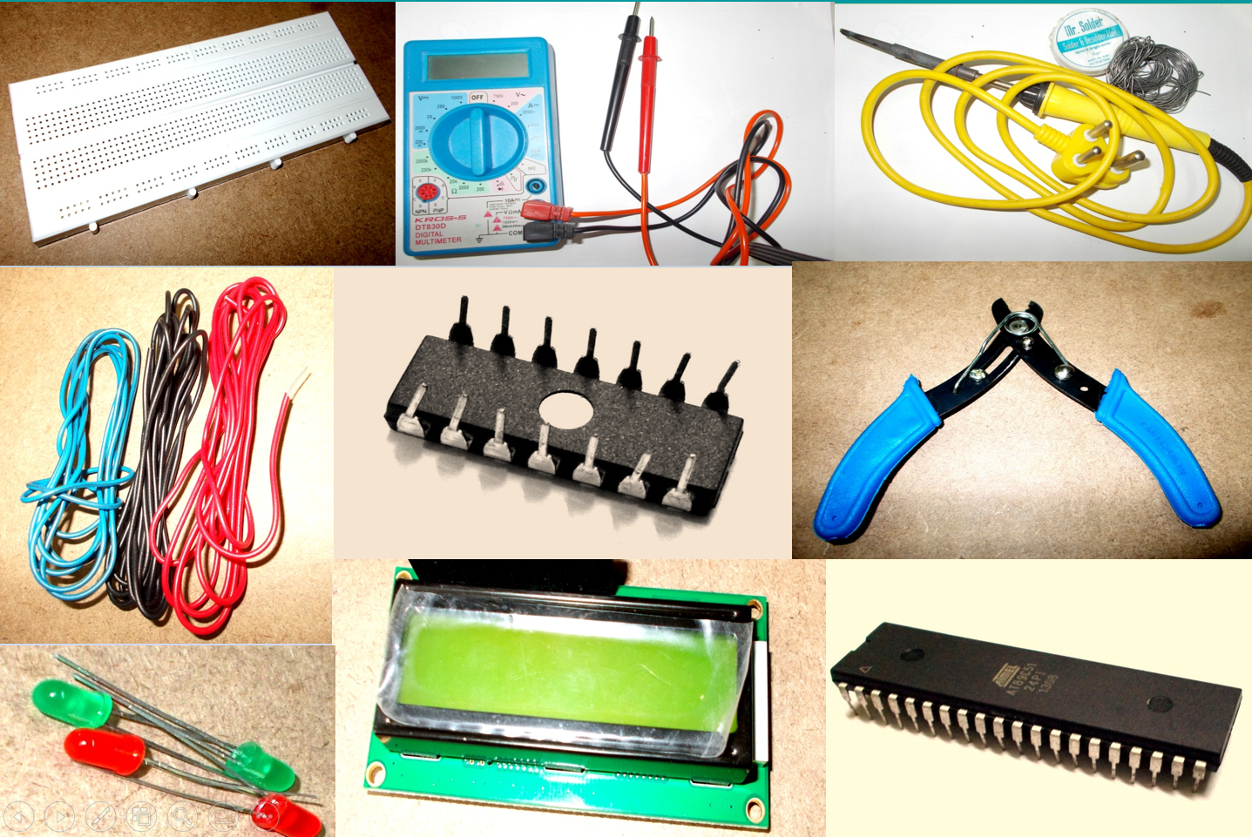
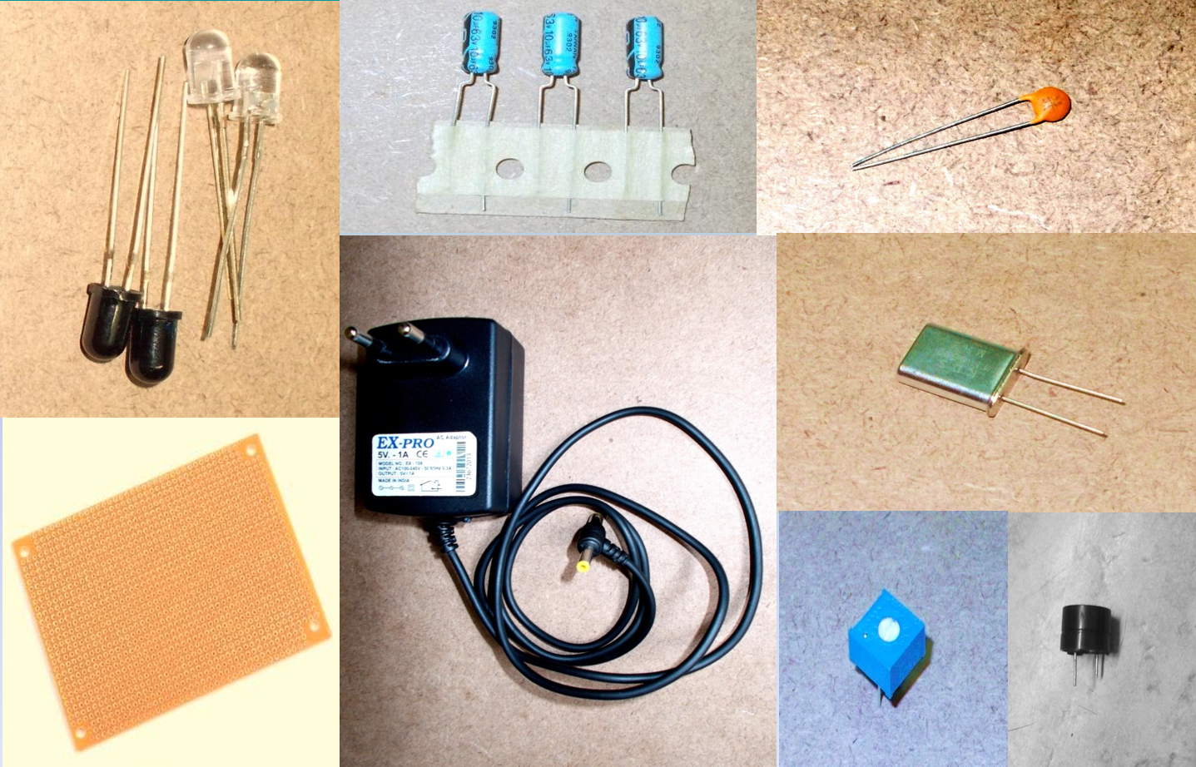
Materials Used
AT89C51 (8051 based Microcontroller)
Development Board
16 x 2 LCD Display
10KΩ Potentiometer
2 x IR Sensors (Reflective Type)
Connecting Wires
Power Supply

Slide 4
Different Sections of the project
Sensor
Display
Microcontroller

Slide 5
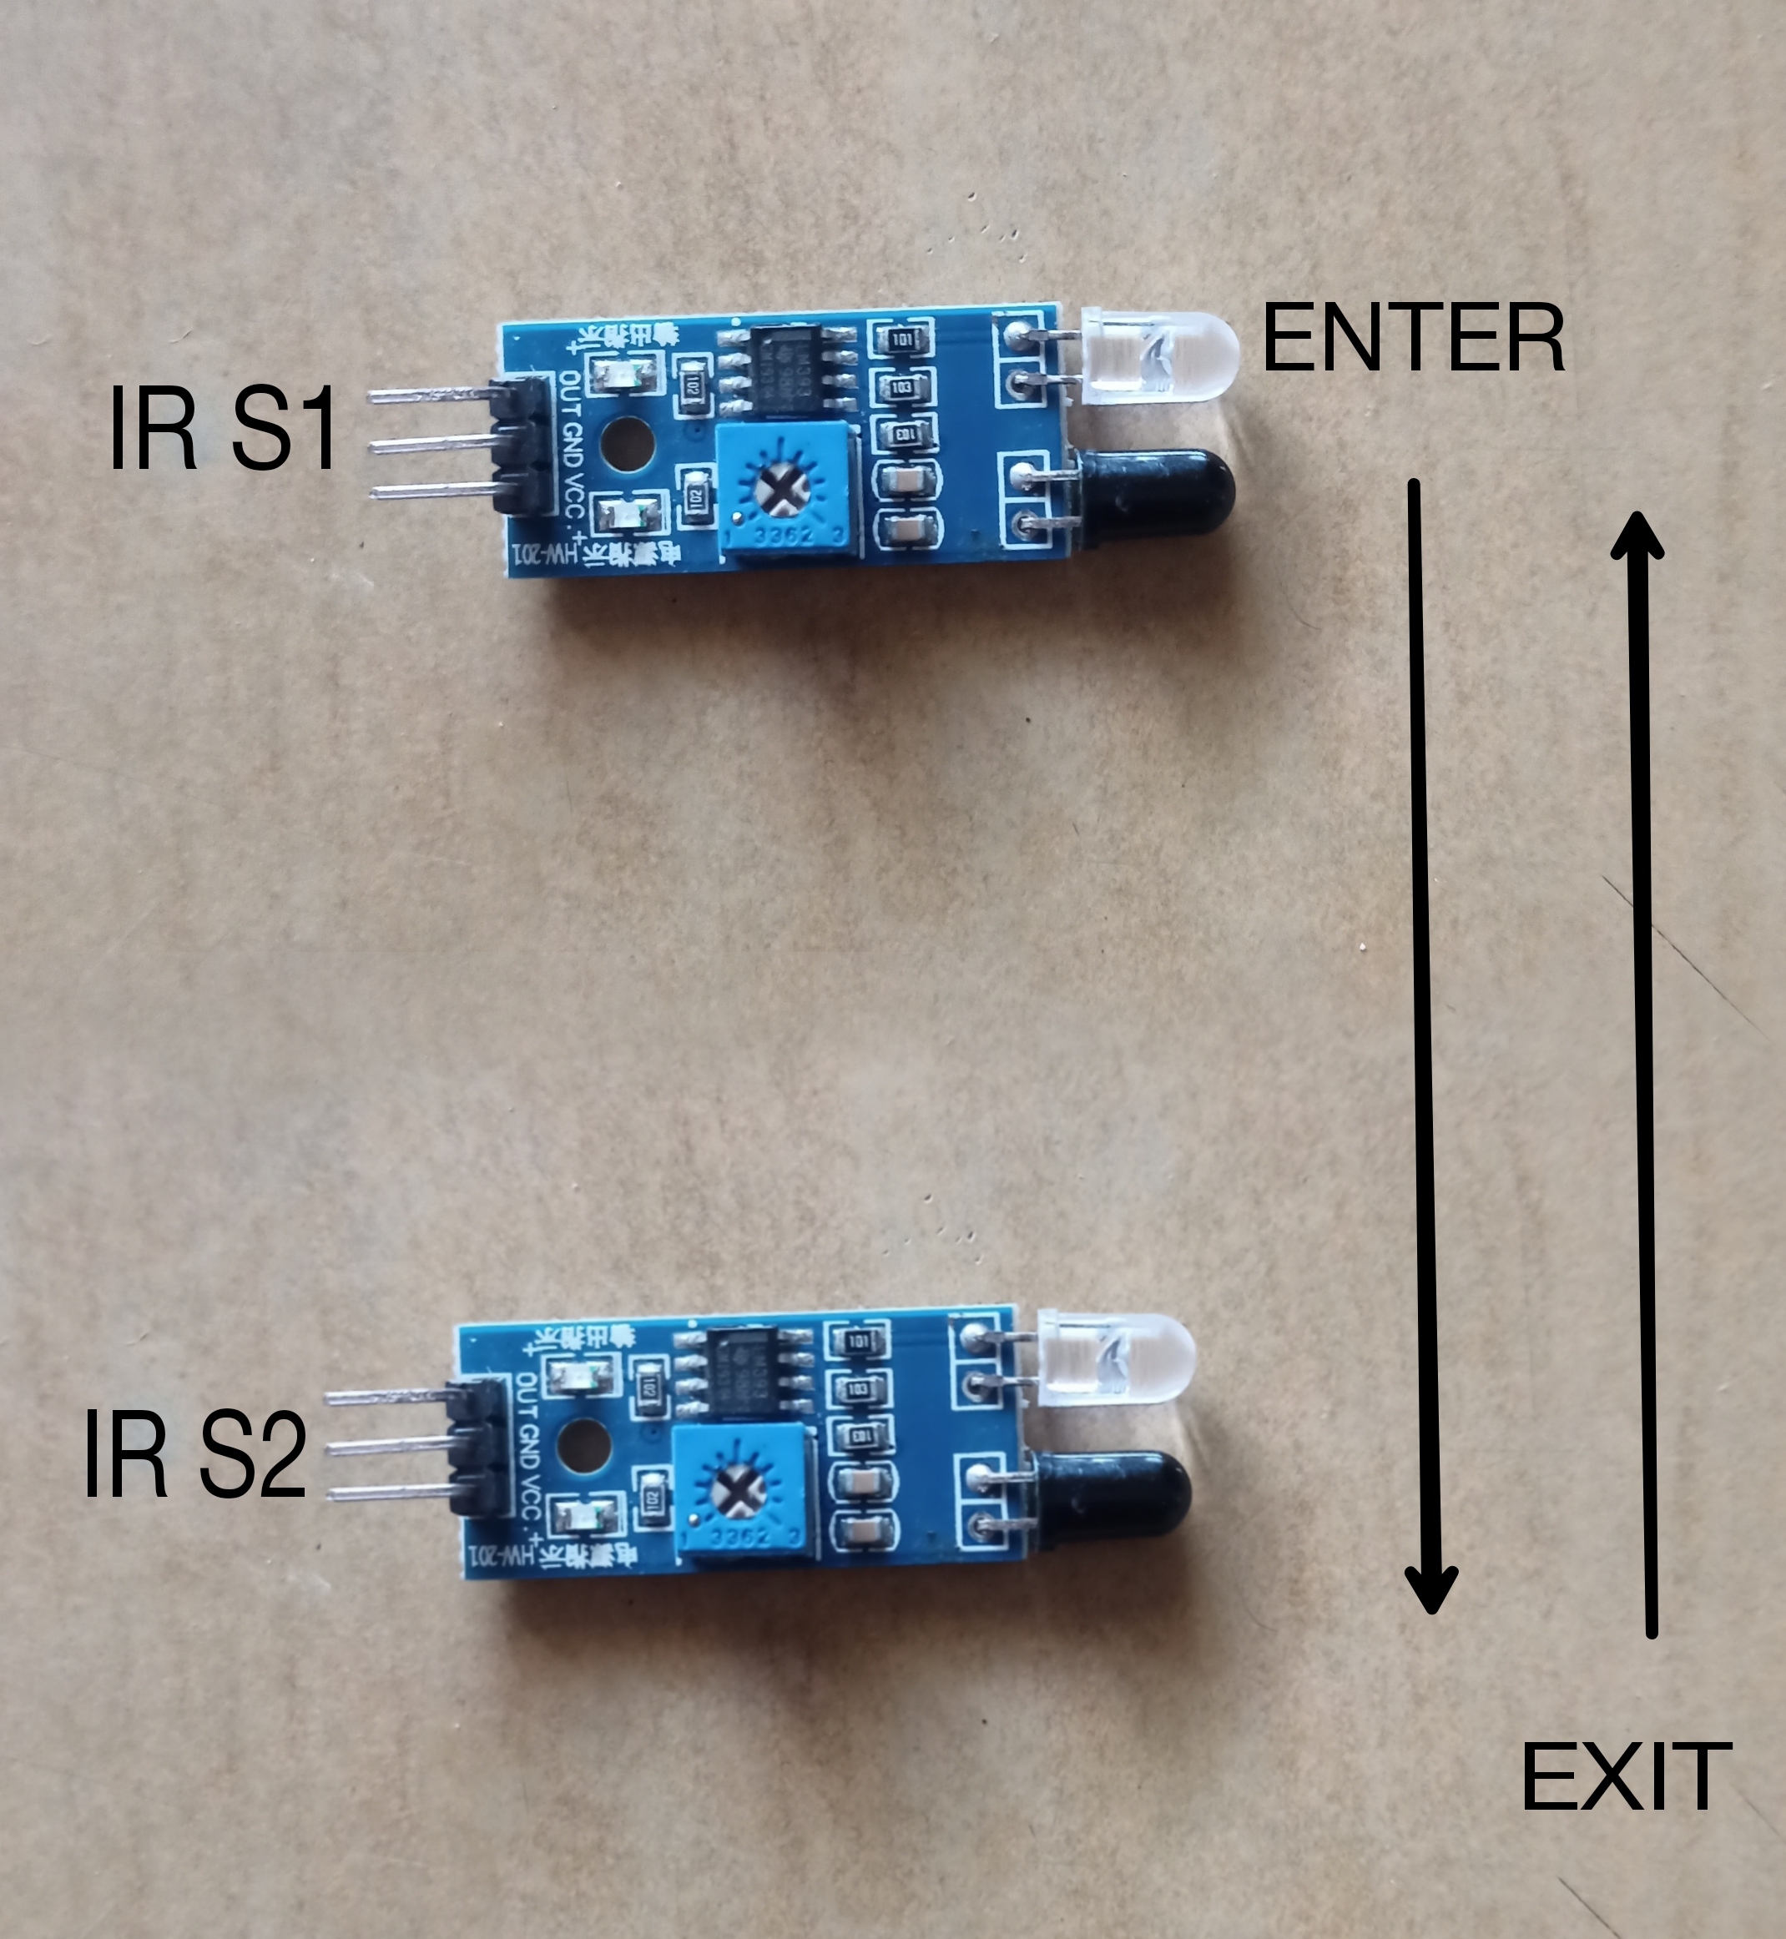
Sensor
A pair of IR Transmitter and Receiver is used at the entry-cum-exit gate. Whenever a person passes through the gate there is an interruption in IR beam and a clock pulse is generated for the microcontroller.

Slide 6
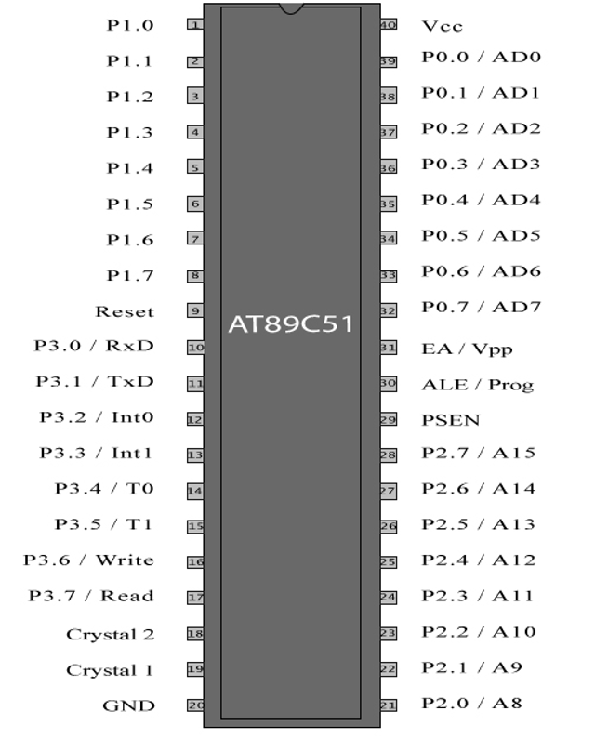
Microcontroller
The AT89C51 is a low-power, high-performance CMOS 8-bit microcomputer with 4Kbytes of Flash programmable and erasable read only memory (PEROM). The device is manufactured using Atmel’s high-density non-volatile memory technology and is compatible with the industry-standard 80C51 and 80C52 instruction set and pin out. The on-chip Flash allows the program memory to be reprogrammed in-system or by a conventional non-volatile memory programmer. By combining a versatile 8-bit CPU with Flash on a monolithic chip, the Atmel AT89C51 is a powerful microcomputer which provides a highly flexible and cost-effective solution to many embedded control applications.

Slide 7
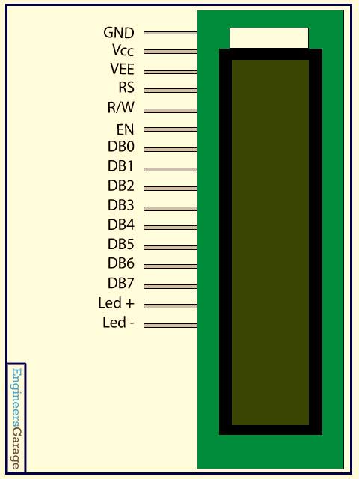
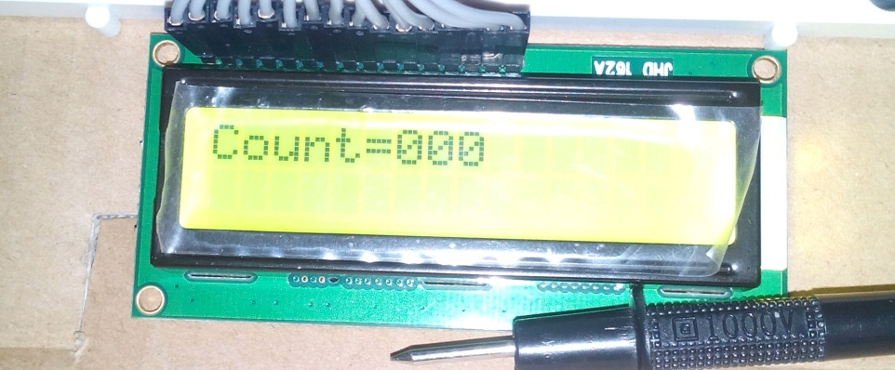
Display
The count is displayed on a 16x2 LCD through the data sent through port 1 which is configured as an output port.

Slide 8
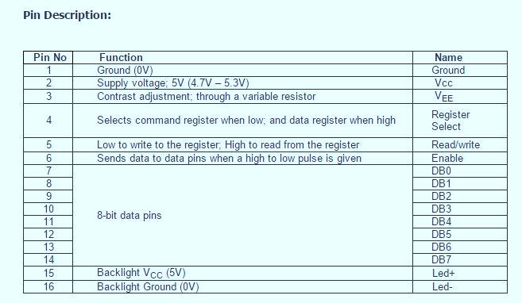

Slide 9
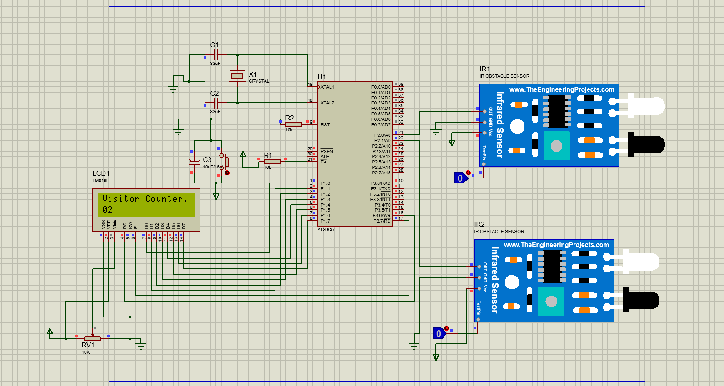

Slide 10
Circuit Operation
The circuit shows the microcontroller based bidirectional visitor counter The IR transmitter-receiver setup at the entrance-cum-exit of the passage is shown at the block diagram. Two similar sections detect interruption of the IR beam and generate clock pulse for the microcontroller.
The microcontroller controls counting and displays the number of persons present inside the hall. When nobody is passing through the entry/exit point, the IR beam continuously falls on IR receiver and detects any passing object within range.
The microcontroller is programmed in such a way that when it will sense low signal at P2.0 it will increment the count by 1 and when it will sense a low signal at P2.1 it will decrement the count by 1

Slide 11
Algorithm
Step 1: Start the process
Step 2: Select port 1 as output port for displaying the count value in LCD.
Step 3: When a low signal is sensed at P2.0, it will wait for low signal at P2.1 if it is there then incrementing the count by 1.
Step 4: When a low signal is sensed at P2.1, it will wait for low signal at P2.0 if it is there then decrementing the count by 1.
Step 5: Display the Count.
Step 6: Continue the process, whenever a low pulse is sensed at pin P2.0 and pin P2.1.

Slide 12
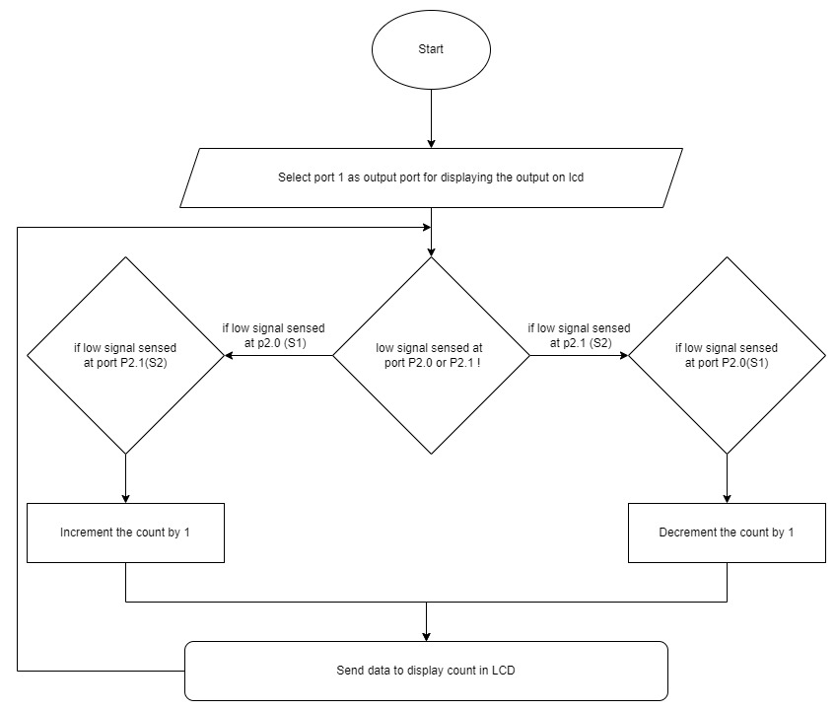
Flowchart

Slide 13
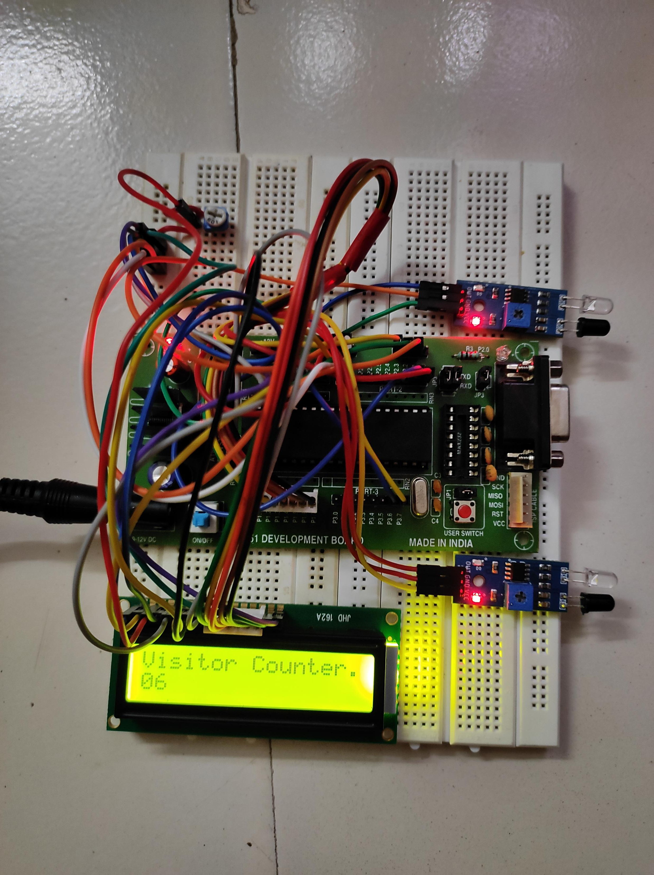

Slide 14
Applications
Uses:
Used to count the visitors of an auditorium, hall, offices, mall, sports etc.
Used as integral part of security system in high confidential areas.
Used in Parking Lot.
Used in Elevator to prevent the maximum limit of weight.
Advantages:
High precision and accuracy can be achieved through it.
Since it is bidirectional it can count in both directions peoples entering and exiting the place.
Since it is compact it can be easily implemented anywhere.
It is also cost effective.

Slide 15
Conclusion
Thus, the project entitled “Bidirectional Visitor Counter” helps to measure the visitor entering and exiting a particular passage or way. The circuit counts both entering and exiting visitors and displays the number of visitors present inside the hall. Visitor counting is not limited to the entry/exit point of a company but has a wide range of applications that provide information to management on the volume and flow of people throughout a location. The visitor helps to maximize the efficiency and effectiveness of employees, floor area and sales potential of an organization. The circuit may also be enhanced with a wide counting range of above three digits by modifying software section of the system. It can also be enhanced for long and accurate sensing range using a laser torch instead of IR transmission circuit. Thus, the circuit can be used to monitor visitor flow in effective manner, where the visitors have to counted and controlled.

